Slide 1


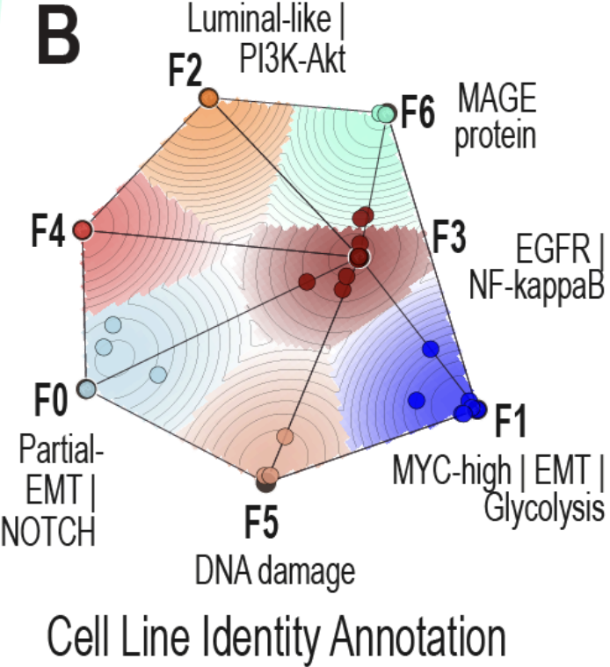
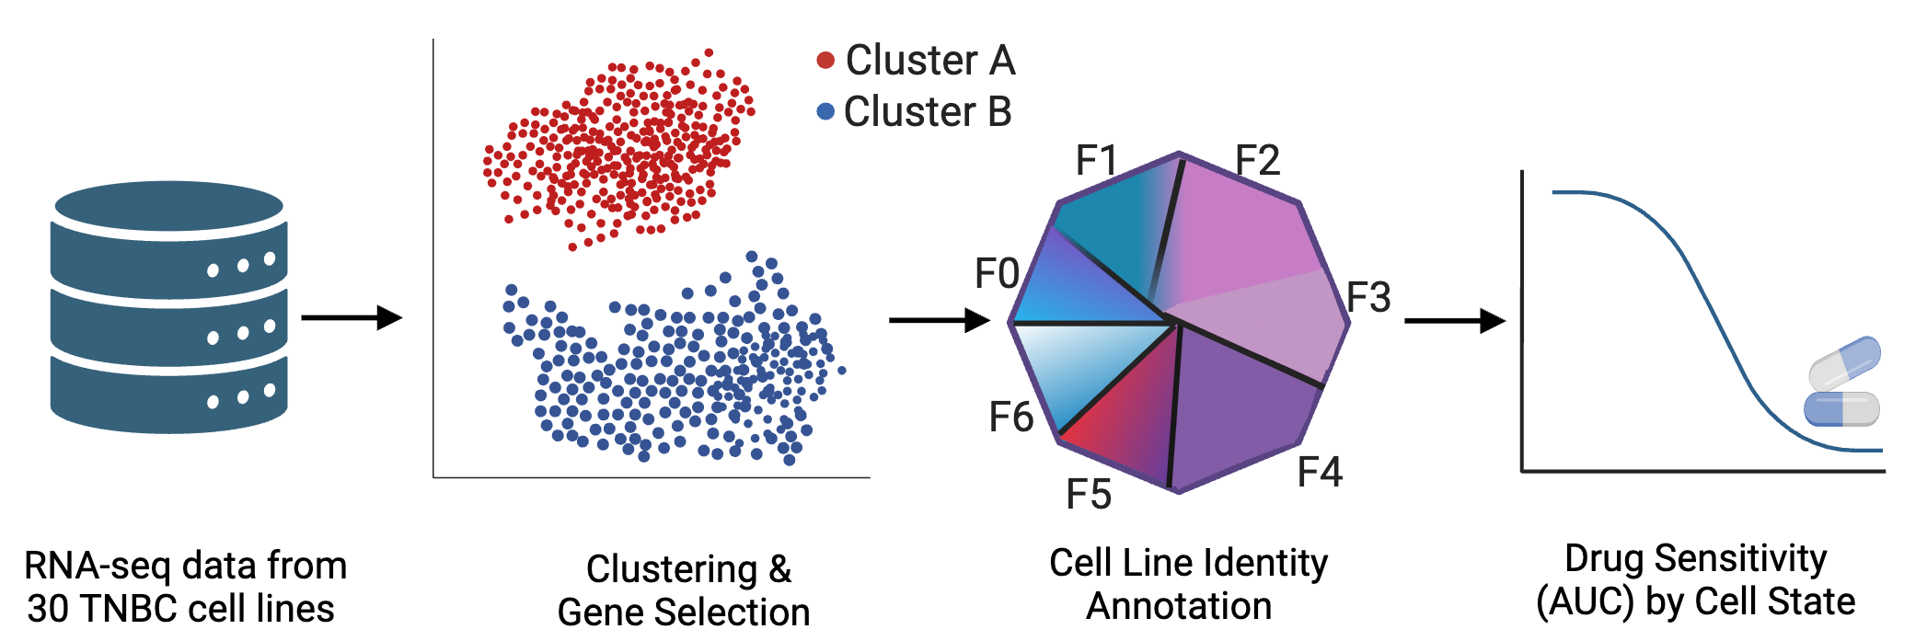
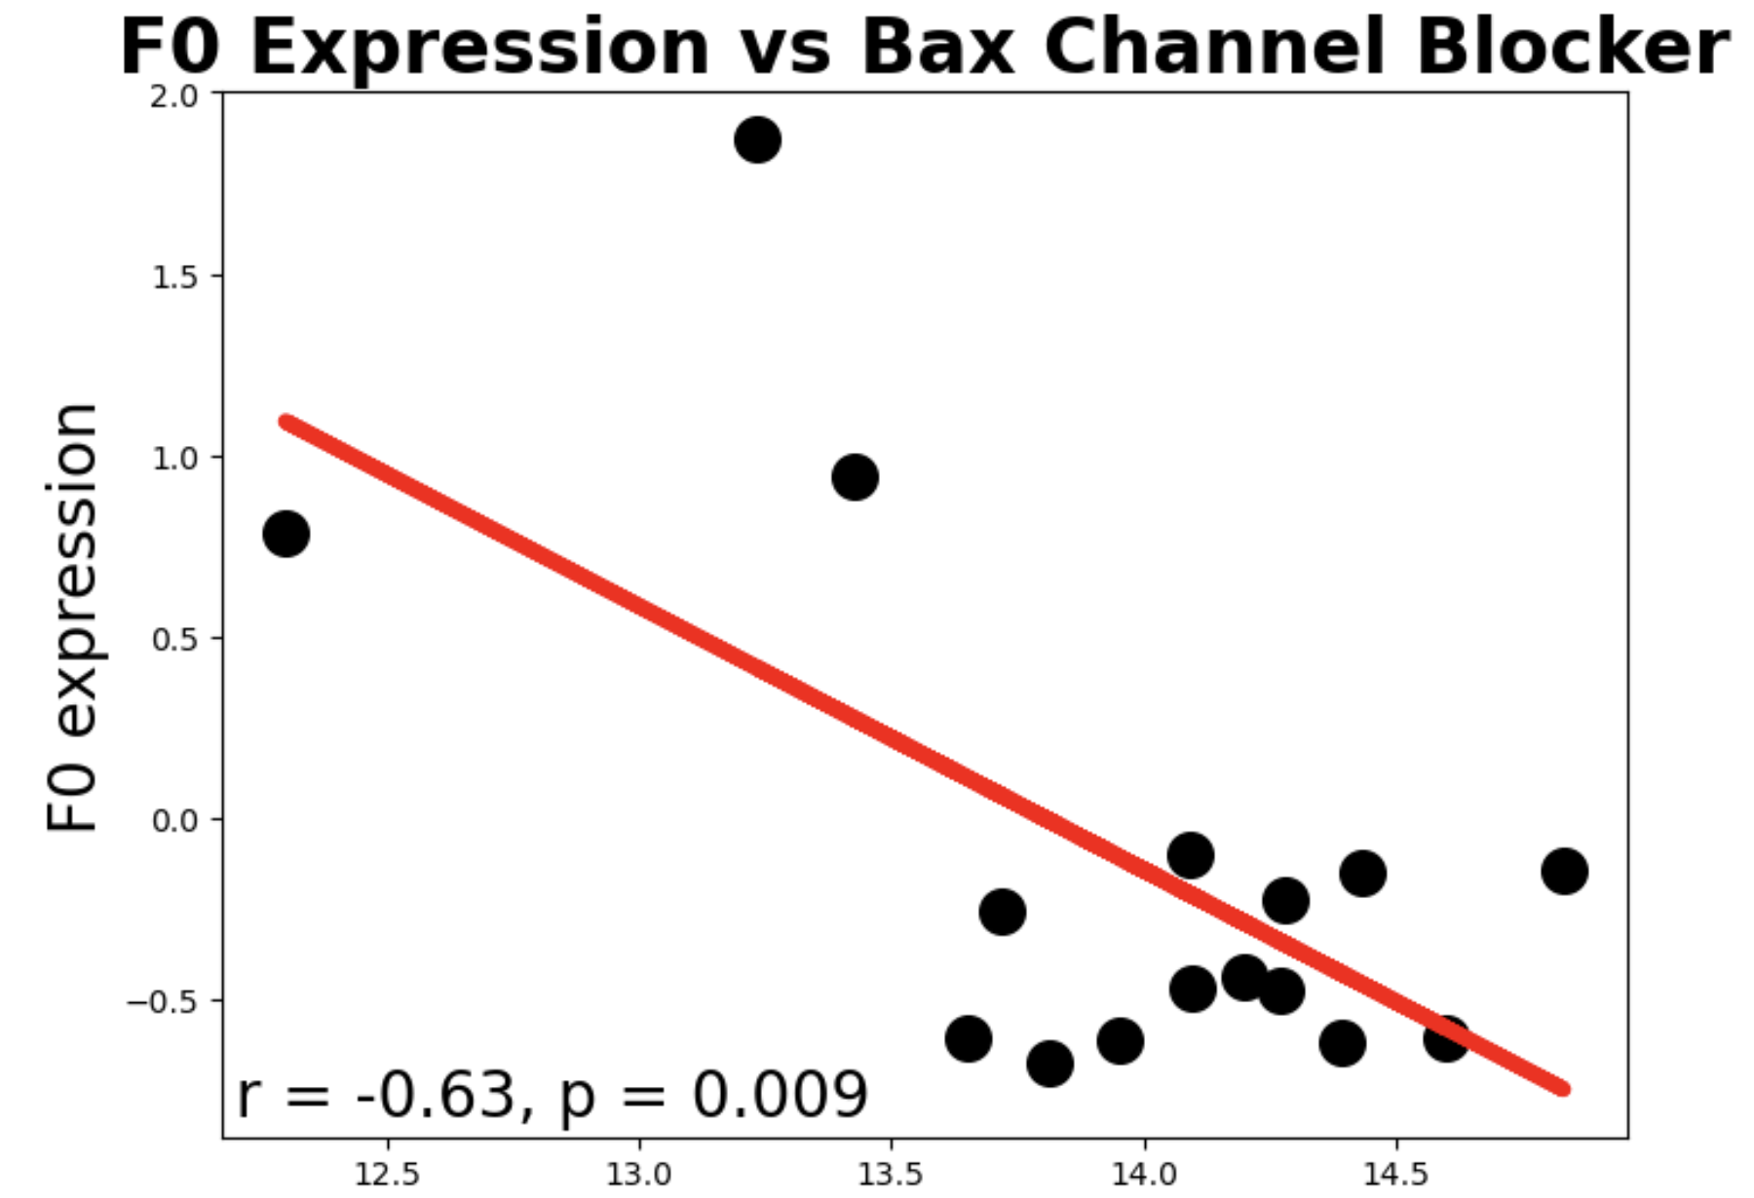
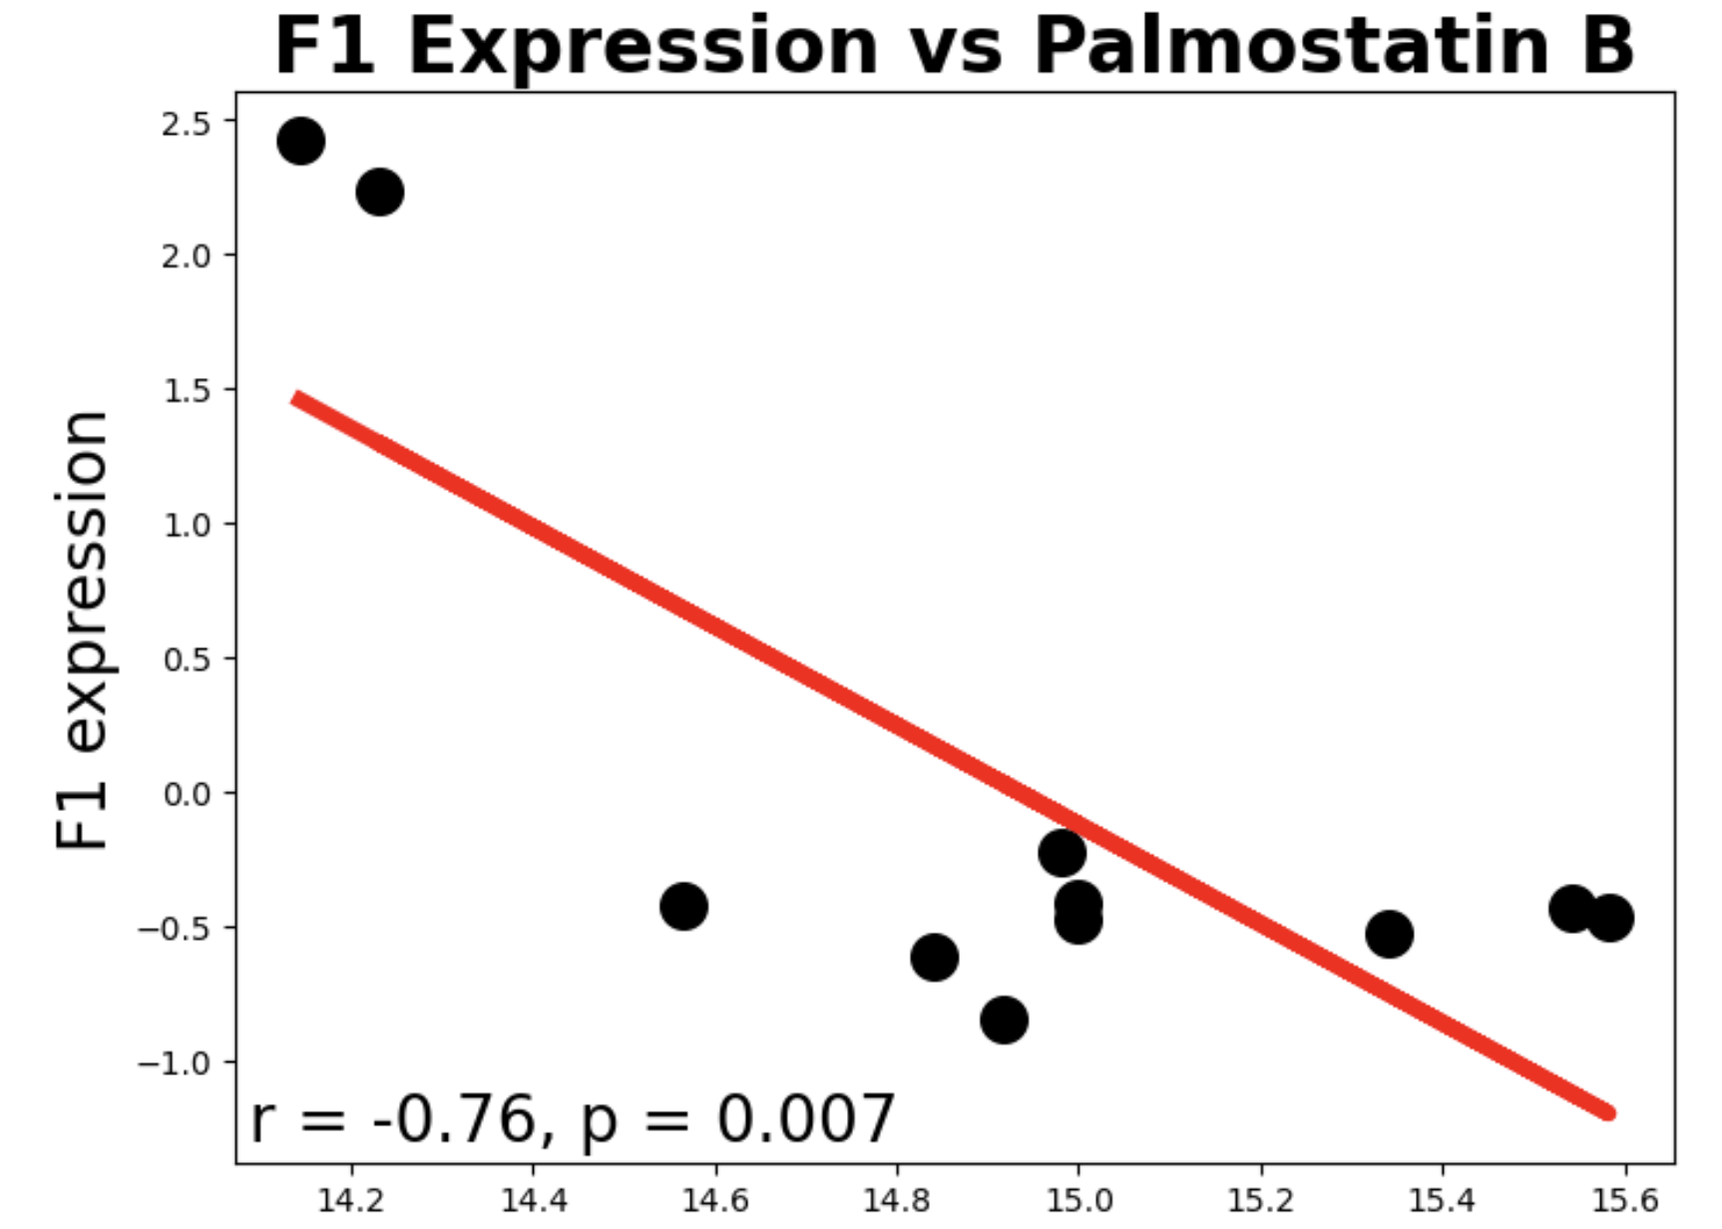
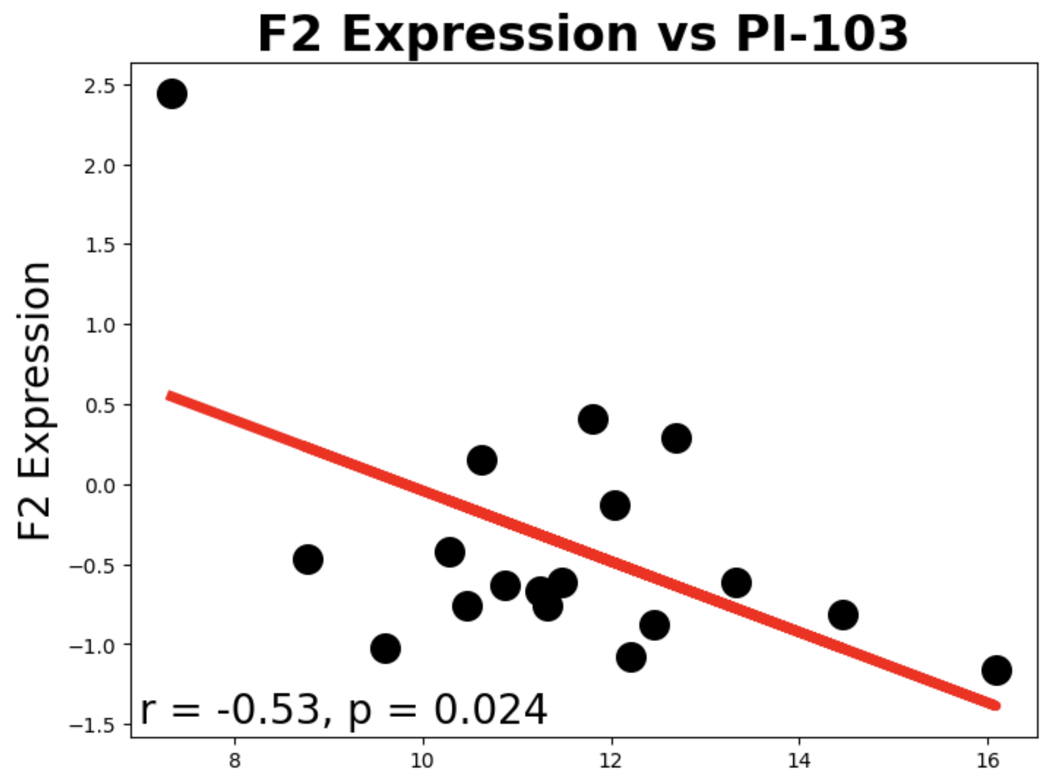
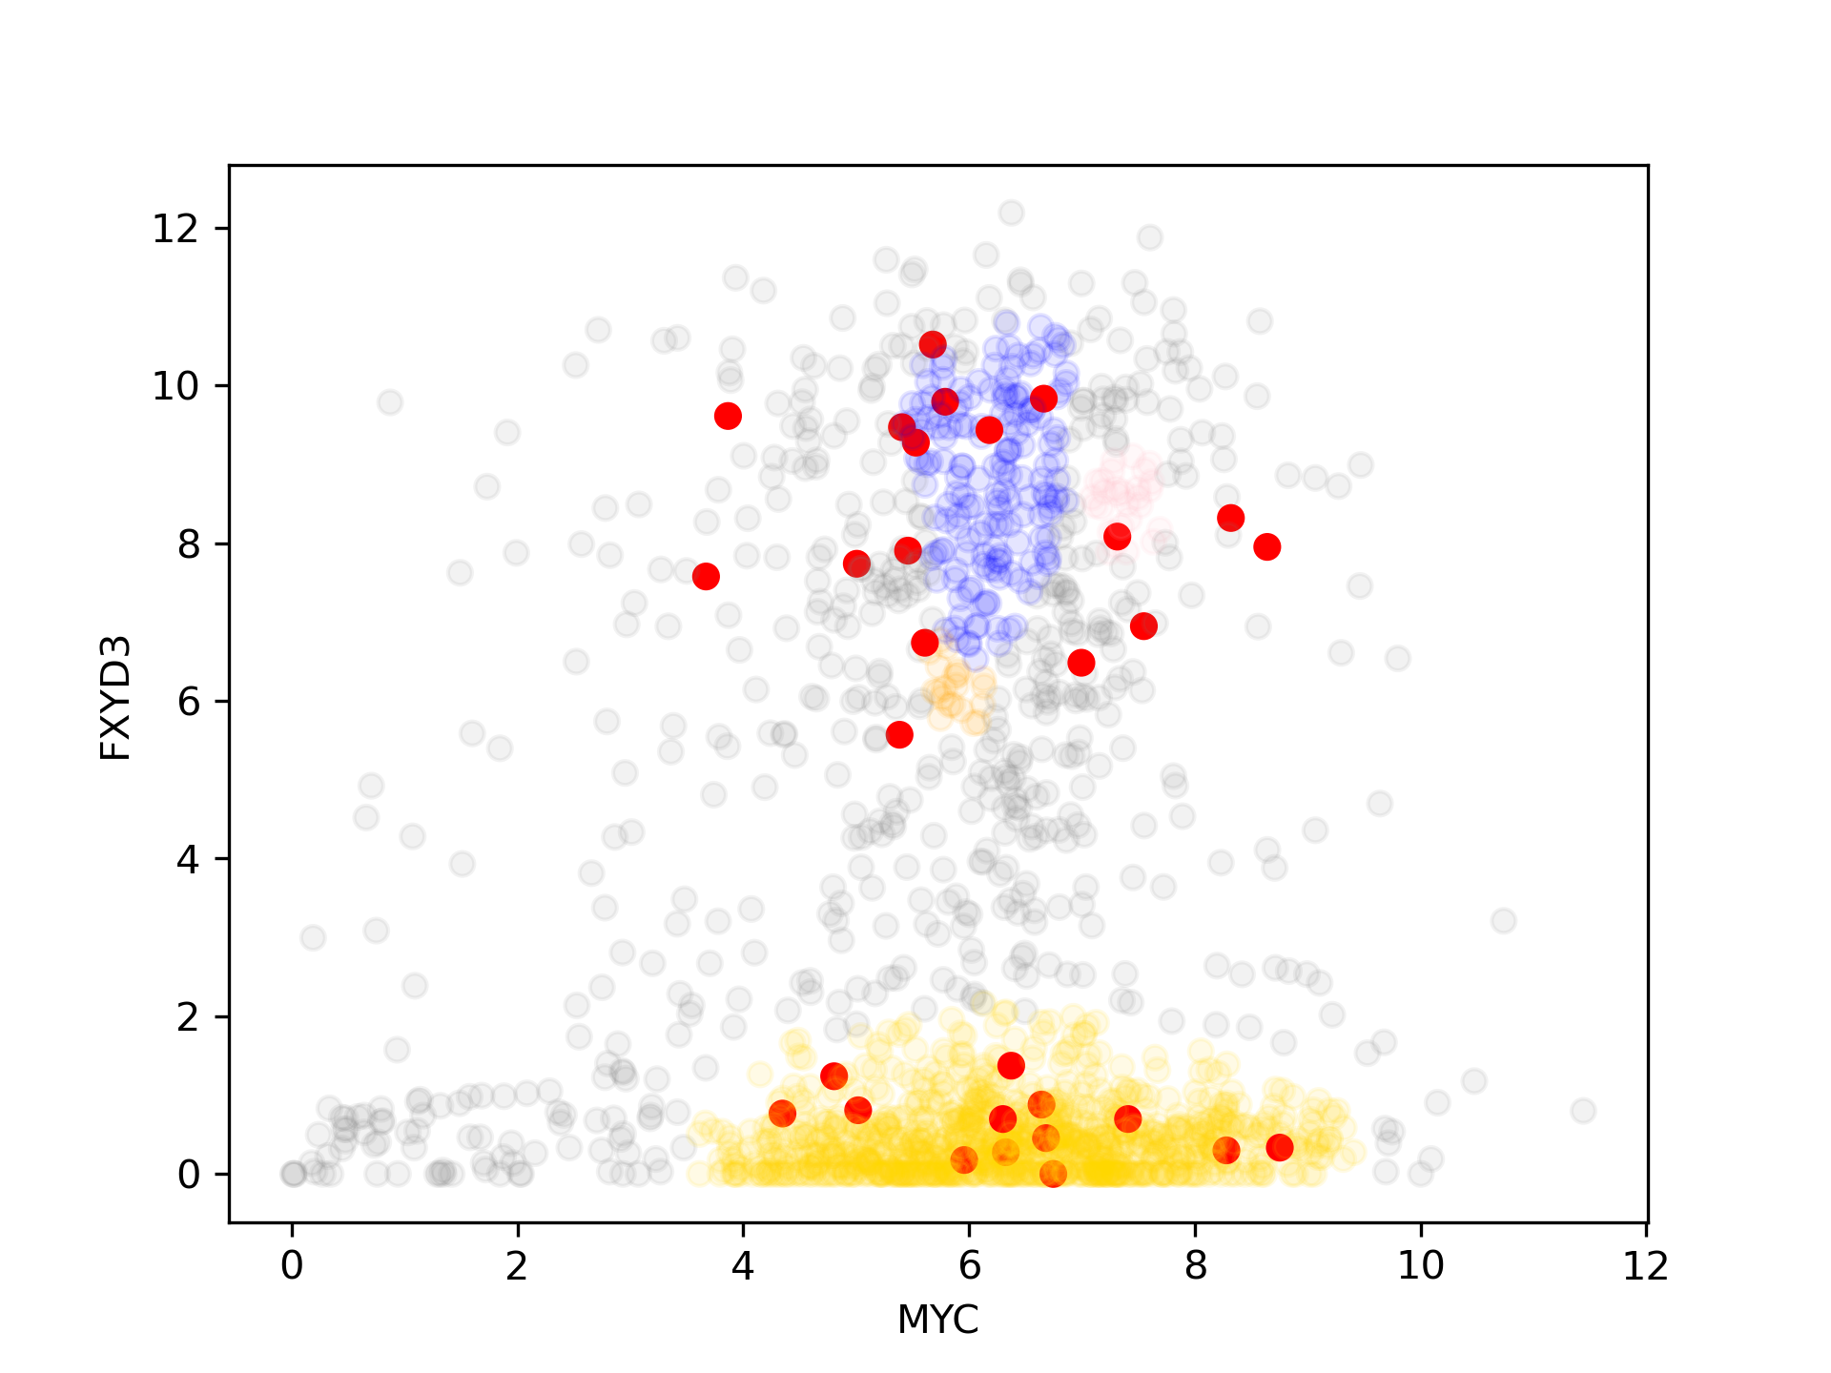
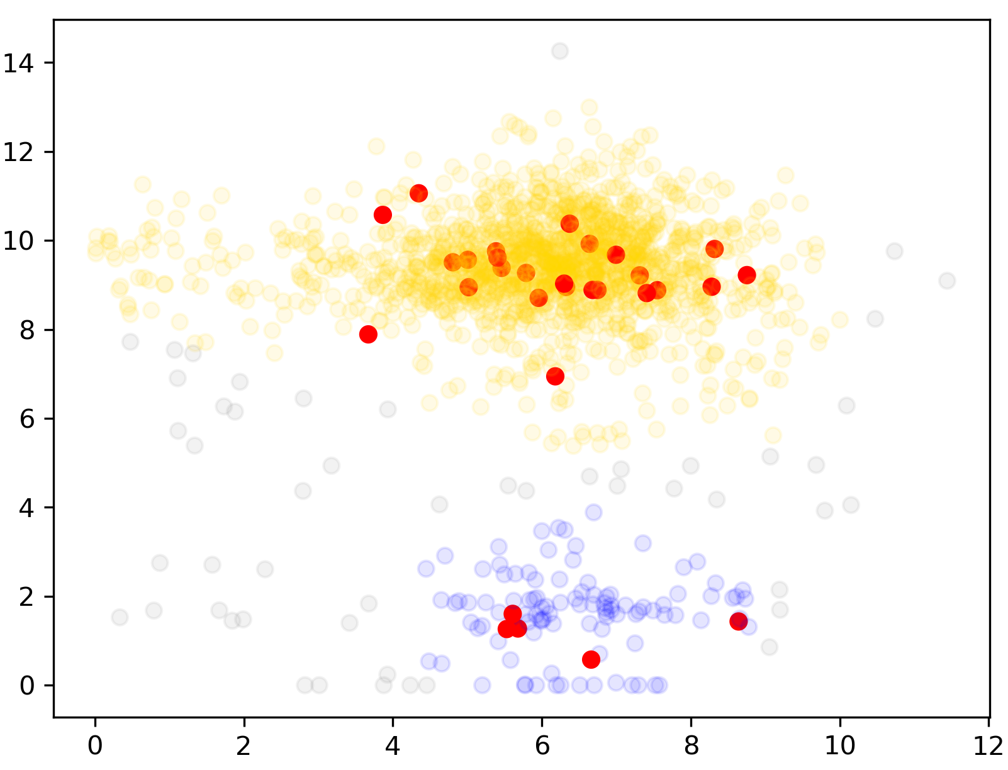
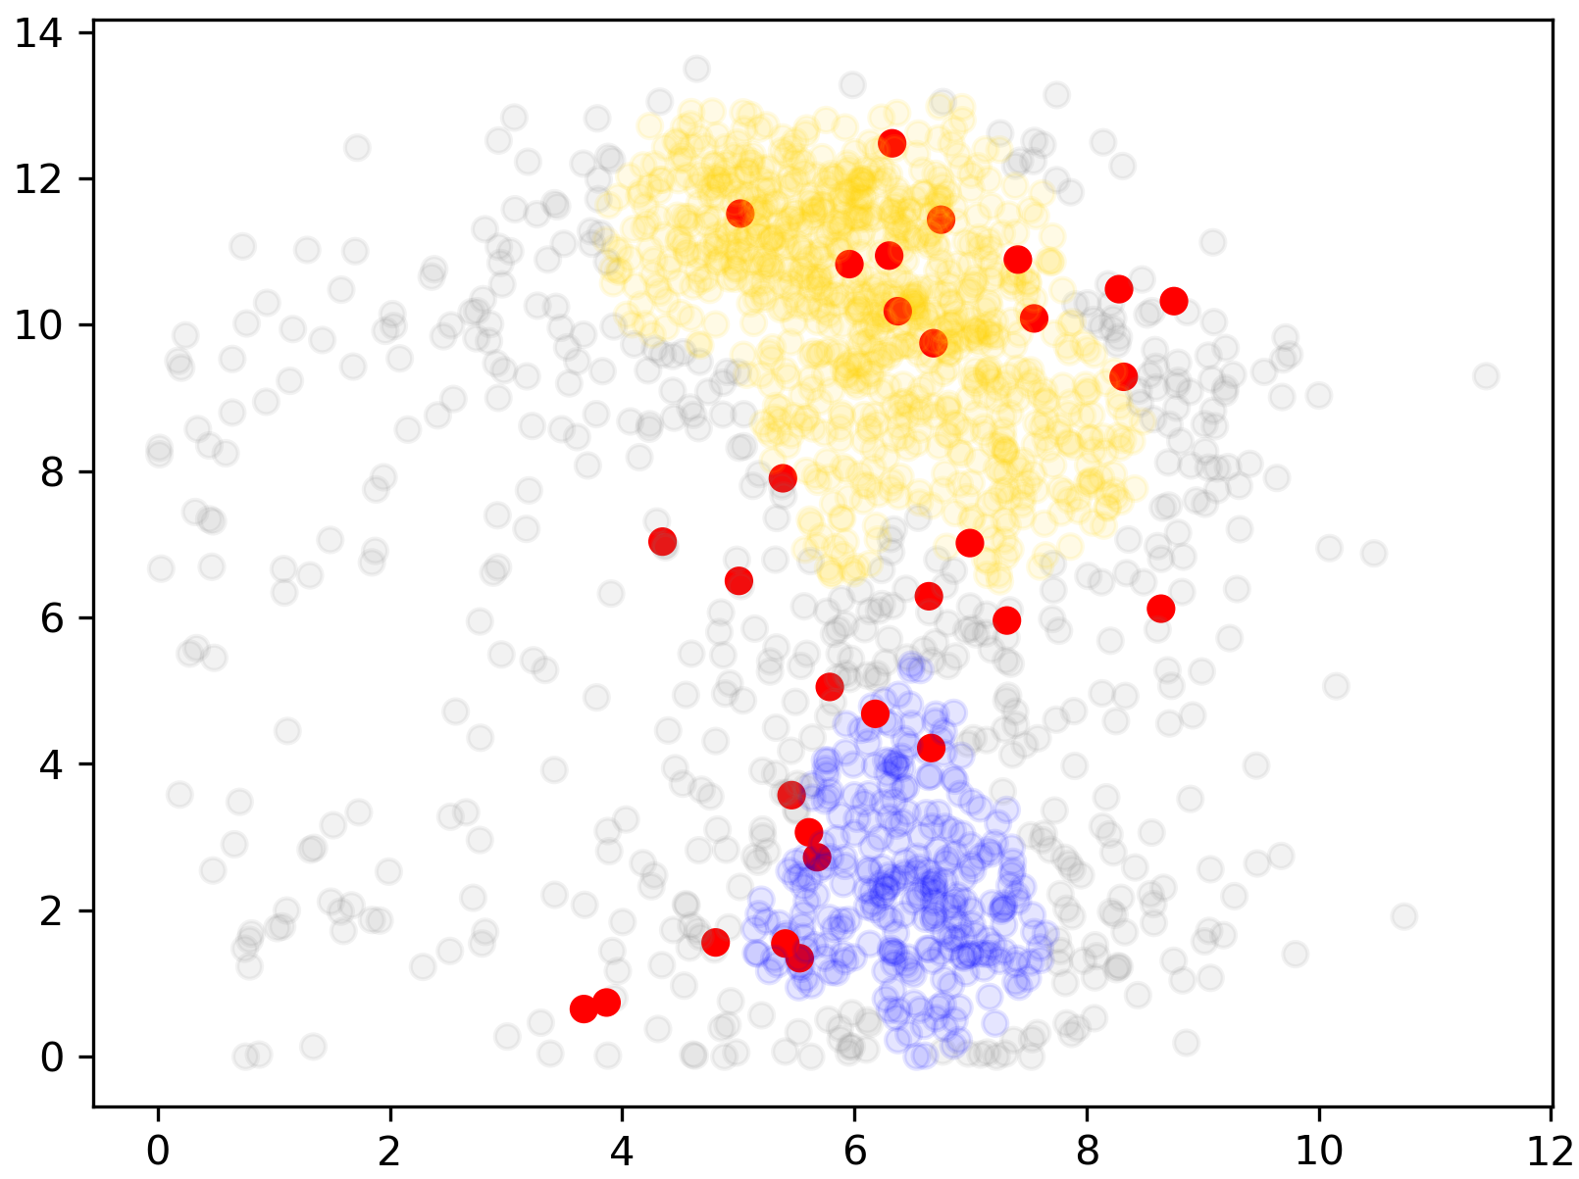
Integrating Gene Expression and Drug Response to Explore Triple-Negative Breast Cancer (TNBC) Heterogeneity
Riham Abdu¹, Yue Wang², Elizabeth Brunk^{2,3}
Department of Genetics, 2. Department of Pharmacology, 3. Department of Chemistry University of North Carolina at Chapel Hill, Chapel Hill, NC
Introduction
Drug Sensitivity Results
Triple-negative breast cancer (TNBC) makes up about 10–15% of all breast cancer cases and is known for its poor prognosis and high relapse rate within five years. TNBC lacks HER2, PR, and ER expression, and thus has no effective targeted therapies available yet. Its high heterogeneity leads to unpredictable treatment responses.
Our aim was to analyze gene expression and drug response data from TNBC cell lines to uncover gene patterns that define distinct cell states and explore how these relate to differences in drug sensitivity.
TNBC Cell Line State Classification by grouping cell lines into seven states (F0–F6) based on 524 signature genes, each linked to biological pathways. Derived from previous work by Wang et al. (2025) [Figure 1B, p. 23]¹
Methods
Compound AUC
State-Specific Drug Sensitivities in TNBC Cell Lines are revealed by strong negative correlations between F0–F2 state expression and compound AUC values, suggesting cell state influences treatment response. Representative compounds include Bax channel blocker (apoptosis inhibitor, F0), Palmostatin B (Ras inhibitor, F1), and PI-103 (PI3K inhibitor, F2)
Gene Selection Results
Conclusions
We developed a model that integrates gene expression and drug response data to explore TNBC heterogeneity.
Our analysis revealed distinct expression patterns that may help explain differences in treatment sensitivity.
This approach provides a foundation for identifying potential drug candidates and personalizing TNBC treatment.
FXYD3 Gene Expression
GSTP1 Gene Expression
VIM Gene Expression
Cluster 1
Cluster 2
References
MYC Gene Expression
¹Wang, Yue, et al. A Multimodal Framework to Uncover Drug-Responsive Subpopulations in Triple-Negative Breast Cancer. bioRxiv, 19 Feb. 2025. bioRxiv,Figure 1B, p. 23.
Dass, Sylvia Annabel et al. “Triple Negative Breast Cancer: A Review of Present and Future Diagnostic Modalities.” Medicina (Kaunas, Lithuania) vol. 57,1 62. 12 Jan. 2021, doi:10.3390/medicina57010062
Created images in methods using biorender
Gene Expression Patterns Differentiate TNBC Cell Lines by highlighting FXYD3, GSTP1, and VIM as representatives from a set of 524 key genes identified through our workflow. Red points mark TNBC cell lines, and the distinct expression patterns suggest these genes could help group TNBCs with similar treatment responses.
Acknowledgements
EDGE Genomics is supported by NHGRI (grant #5R25HG012219-02) and the UNC Program for Precision Medicine in Health Care

